Slide 1
Kintner Crossing – Amendment to existing PRD zoning
Presentation to the City of Sunbury Planning and Zoning Commission
March 25, 2024

Slide 2
Who We Are
Developer/Builder – D.R. Horton – Indiana, LLC
Jack Mautino, Division President
Dave Dozer, Division Vice President of Land Development
Andrew Dyer, Land Acquisitioner
Joe Looby, Senior Planner, EMH&T
Molly Gwin, attorney

Slide 3
What we are asking for…
While this was filed as a rezoning application, this is an existing Planned Residence District, previously approved by this Commission and the City of Sunbury City Council. Most of the plan changes herein are additional detail that are typical as the developer moves through final engineering.
We are asking for the zoning of the property to stay the same, with the primary changes being
an adjustment to the town home product for fee simple, platted lots;
and the removal of the access to Cheshire Rd.

Slide 4
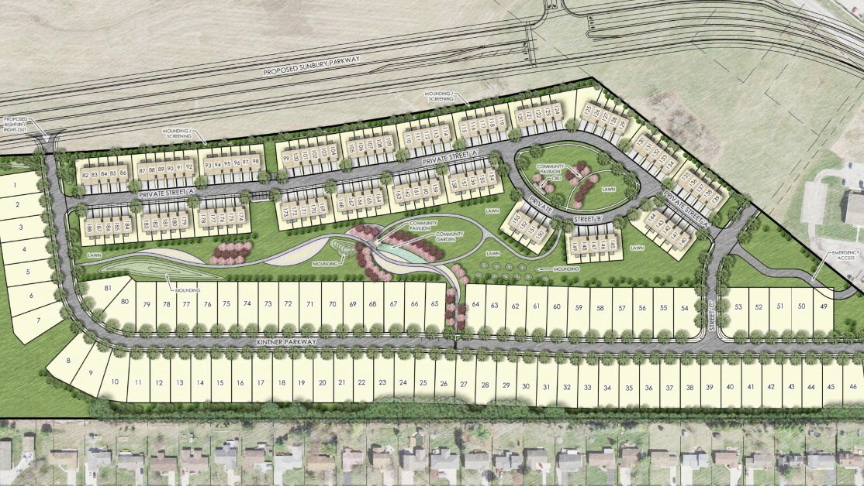

Slide 5
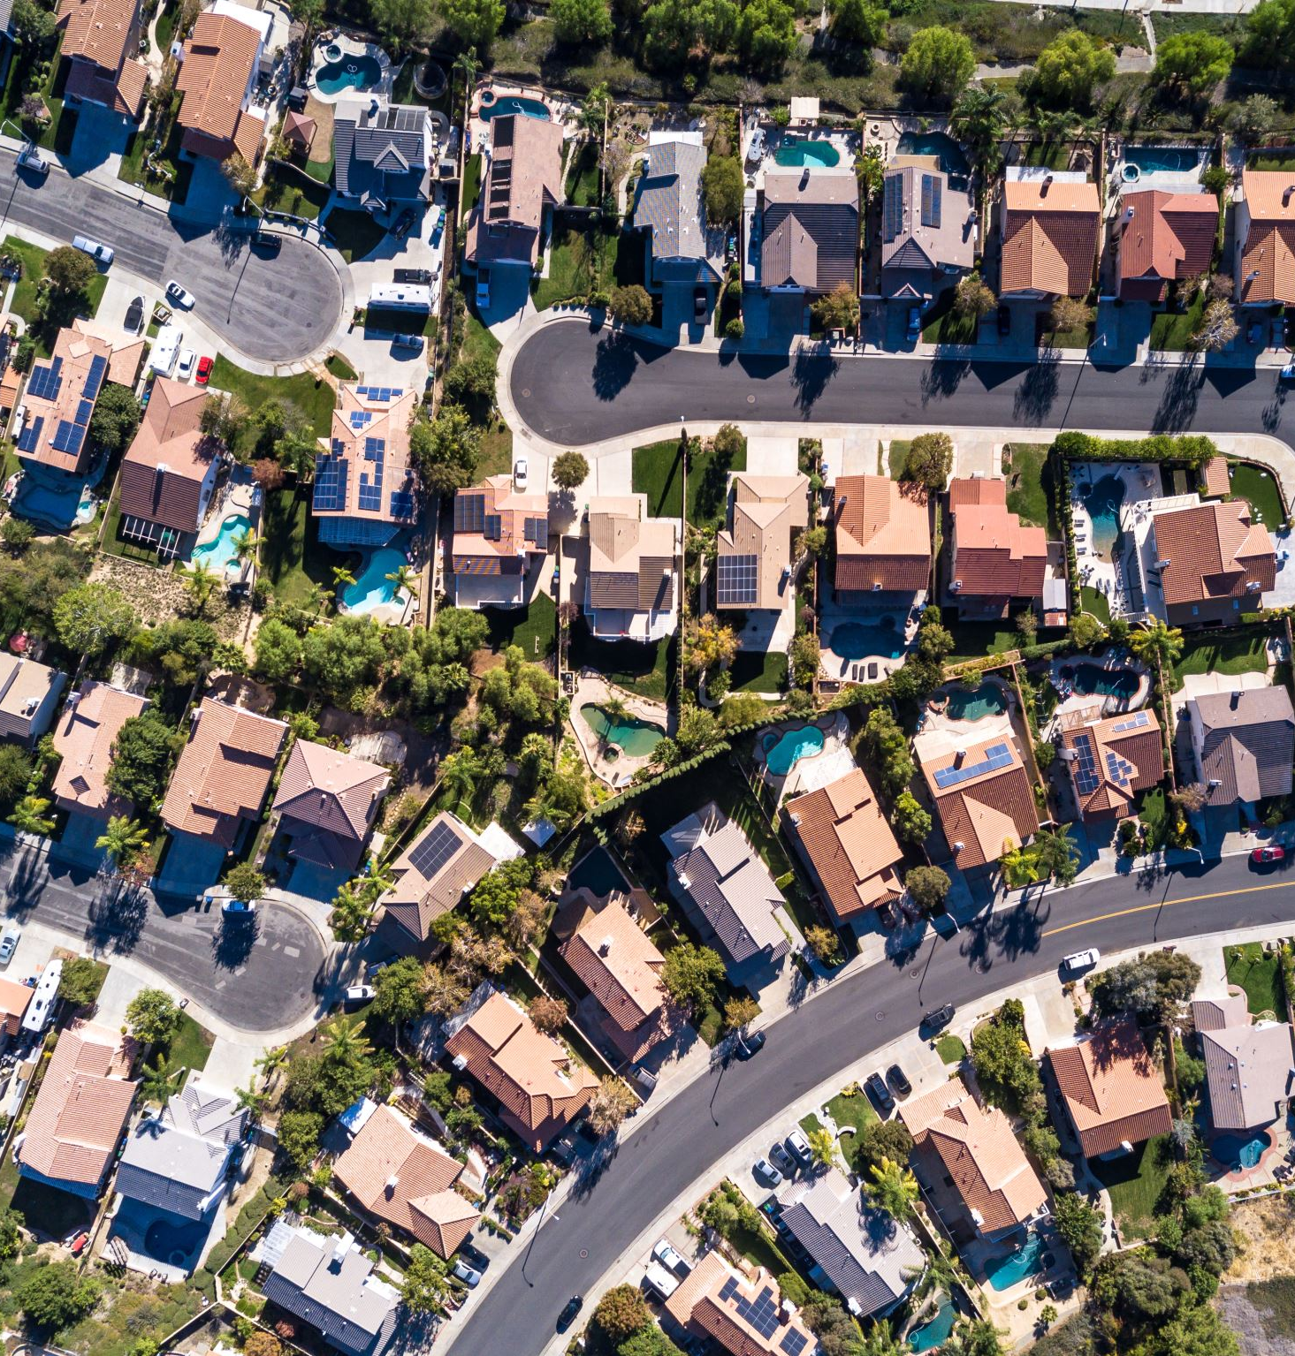
Kintner Crossing
Previously zoned to a PUD.
81 single family homes
107 town homes
2 phases
Phase 1 – 39 single family lots, 44 town homes
Phase 2 – 42 single family lots, 63 town homes

Slide 6
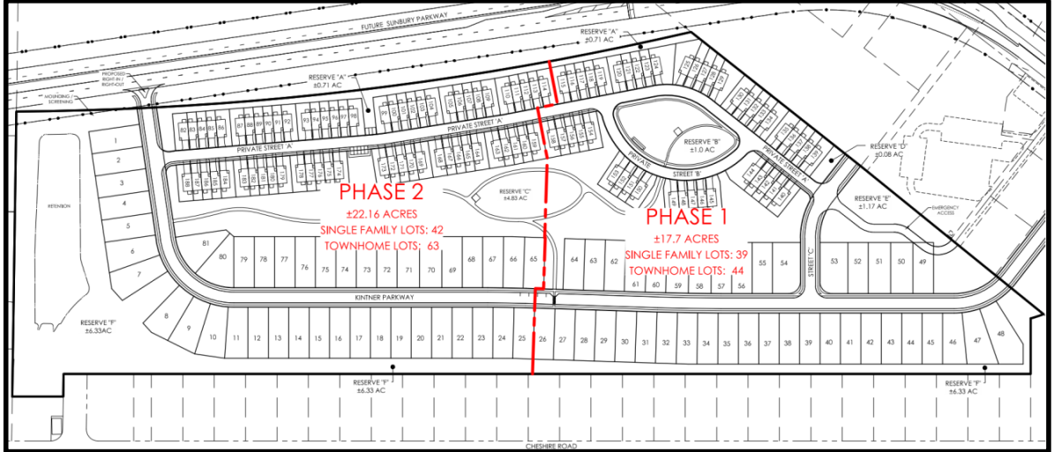

Slide 7
Changes from the Original Approved Development Plan
Town homes to be platted on individual lots, on private streets.
Removal of condominium form of ownership.
Removal of the access point to the south to Cheshire Rd.
Basin/retention pond on the western boundary of the development has been appropriately sized.
Open space has been added along the southern property boundary.
Location of the common mailboxes.
Addition of a temporary emergency access the development, with approval of the location by the B.S.T. & G. Fire District.

Slide 8
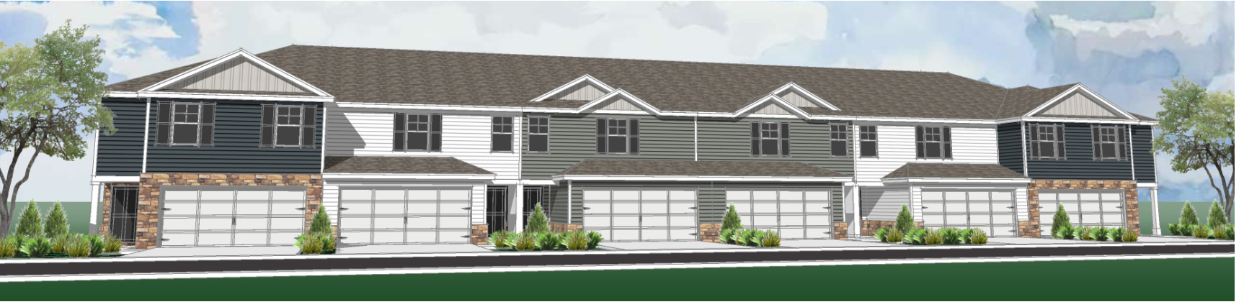

Slide 9
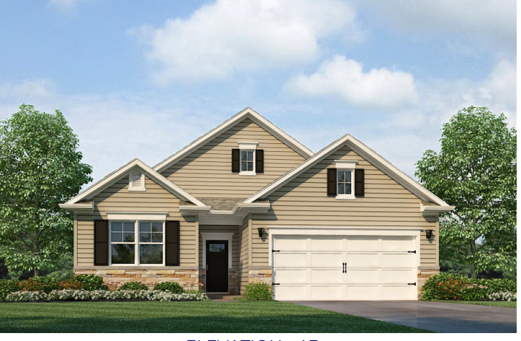

Slide 10
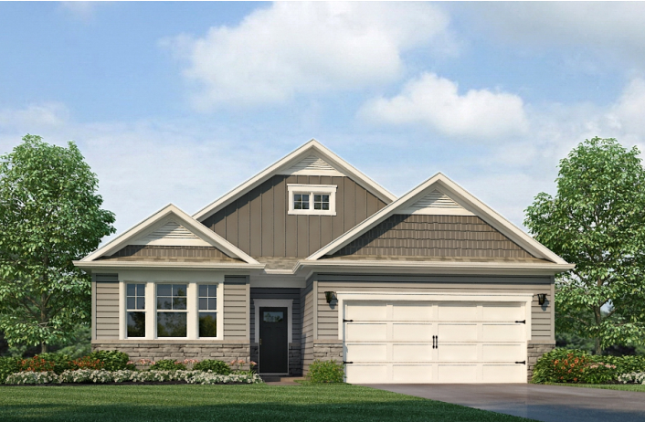

Slide 11
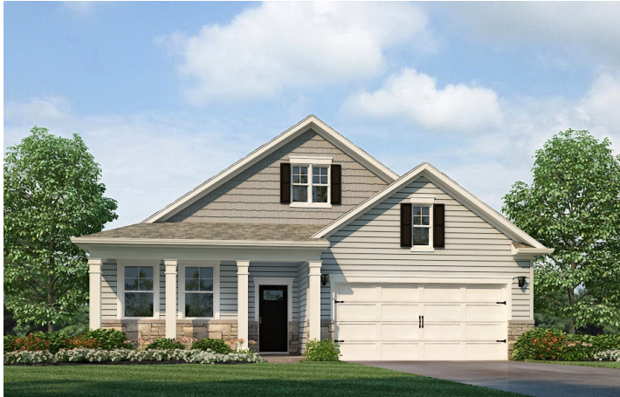

Slide 12
Open Space
Prior Plan broke down “Common Open Space” versus “Additional Open Space”
Common Open Space + Additional Open Space = 36%
Both the common open space and the additional open space will be active open space areas and owned by the HOA.
The retention pond is not included in the open space
Common Open Space – 7.0 acres (20%)
Additional Open Space – 5.87 acres.

